Slide 1
Linear model theory
Interactions

Slide 2
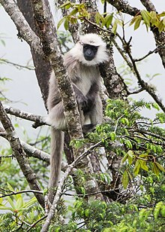
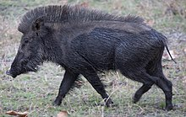
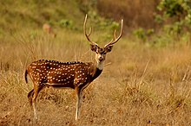
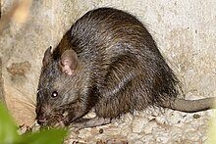
The question
How much do species impact crop yields?
Important to understand in cases where herbivore abundance is increasing dramatically
Different species damage plants in different ways
Different species can east more or less crops

Slide 3
The question
Experimental approach
Four Indian herbivores
Measure damage caused by each to same plant
Controlled density of each species
We want to understand how each species influences VOC emission
So, crop ~ species + density?

Slide 4

What might the results look like?
So, crop ~ species + density?
By including species, we allow for each species to have their own intercept ($β_{0,…,3})$
But we only have a single parameter to describe density, so all species have the same slope ($β_{4}$)
Does that make biological sense?

Slide 5
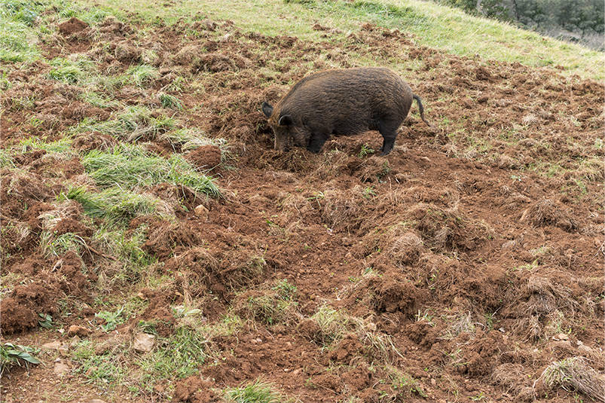
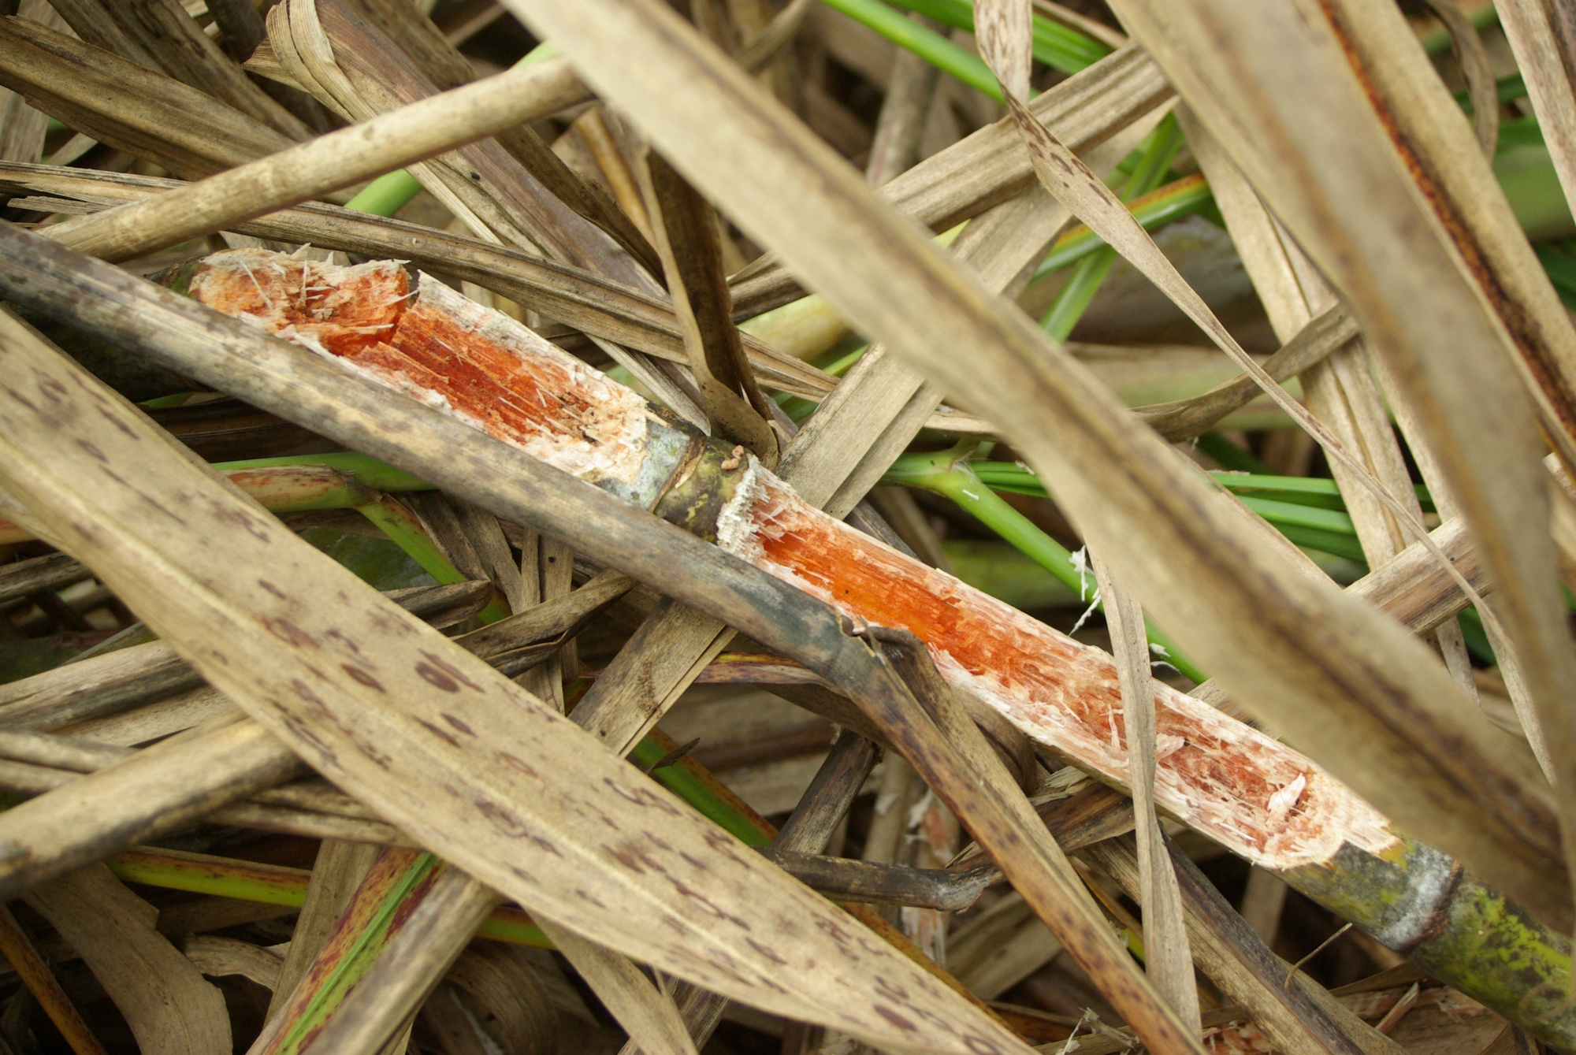
Biological sense?
Species clearly differ
The damage done by each species clearly differ
One boar eats a lot more than one rat
Having 1,000 boar in your field is not the same as 1,000 rats

Slide 6

How do we say 1 rat $≠$ 1 boar?

Slide 7
Is my coffee sweet?
Using only the following information, is my cup of coffee sweet?
I have a cup of coffee
Is my coffee sweet?

Slide 8
Is my coffee sweet?
I have a cup of coffee
I have stirred the coffee with a spoon

Slide 9
Is my coffee sweet?
I have a cup of coffee
I have added sugar to the coffee

Slide 10
Is my coffee sweet?
I have a cup of coffee
I have added sugar to the coffee
I have stirred the coffee

Slide 11
Is my coffee sweet?
To answer question you need to know both pieces of information
Need to appreciate that both need to occur
How do we tell the model this?

Slide 12
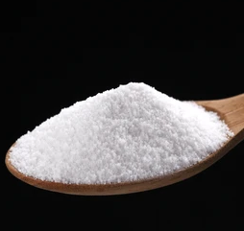

Main effects
Will my tea be sweet?
Sweet ~ sugar + stir
From this, the model doesn’t know that both need to occur at the same time
What if I stirred, but didn’t add sugar?
Treats both variables as being independent of each other
Maybe sweet?
Maybe sweet?
Not Sweet
Not Sweet

Slide 13
What is an interaction?
Interactions specify that an outcome is a result of specific combinations of more than one variable
The effectiveness of a covariate, depends on the other covariate
Sweet ~ sugar * stir
Sweet
Not Sweet
Not Sweet
Not Sweet

Slide 14
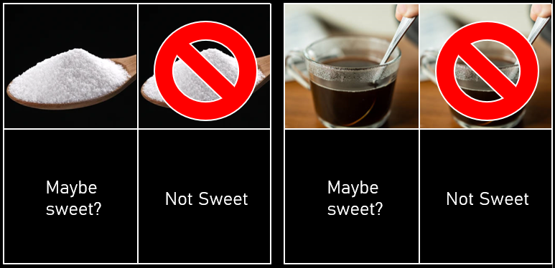
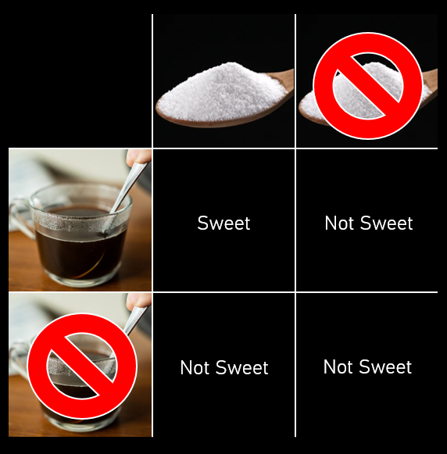

Two ways to specify interactions
The “formal” option
Sweet ~ sugar + stir
+ sugar : stir
$μ_{i}=β_{0}+β_{1}×S_{i}+β_{2}×T_{i}$
$+ β_{3}×S_{i}×T_{i}$
The “shortcut” option
Sweet ~ sugar * stir
$μ_{i}=β_{0}+β_{1}×S_{i}+β_{2}×T_{i}$
$+ β_{3}×S_{i}×T_{i}$

